Slide 1
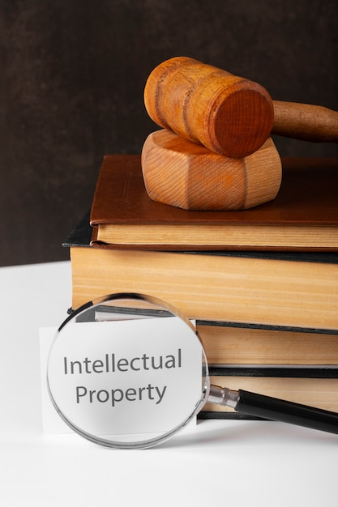
Intellectual Property Online: Is Strong Control Necessary or Even Possible?
REPRESENTED BY:
MEHMOONA KANWAL
TEHREEM QAYYUM
ZAINAB KHAN

Slide 2
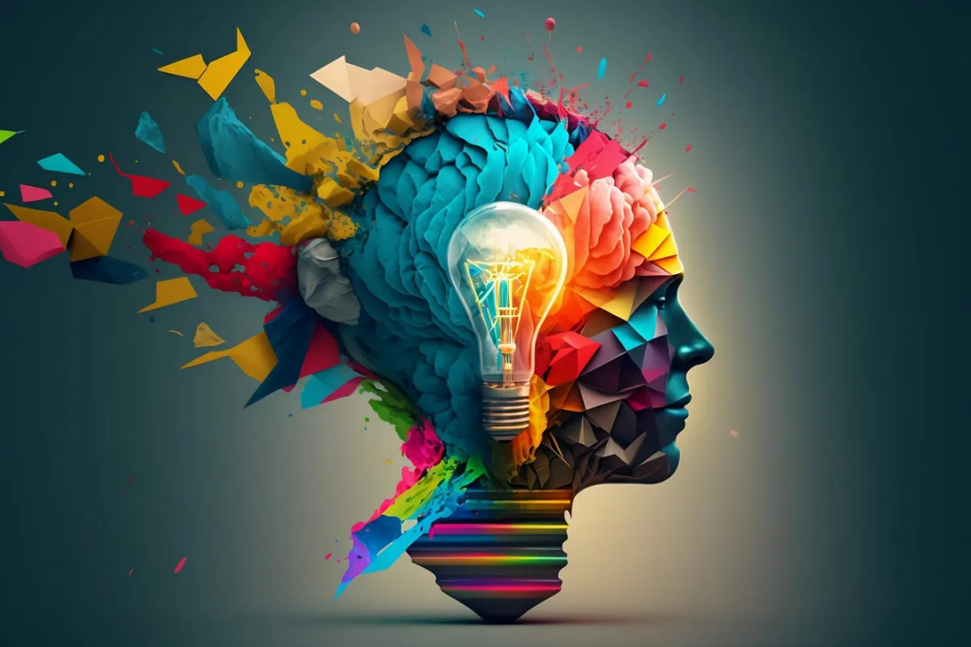
INTRODUCTION
intellectual property refers to creations of the mind, such as art, literature, music, inventions, and designs, that are legally protected as personal assets.
The internet is a platform for sharing creativity globally.
Provides opportunities for writers, musicians, and artists to showcase talent.
Intellectual creations are considered personal property.

Slide 3
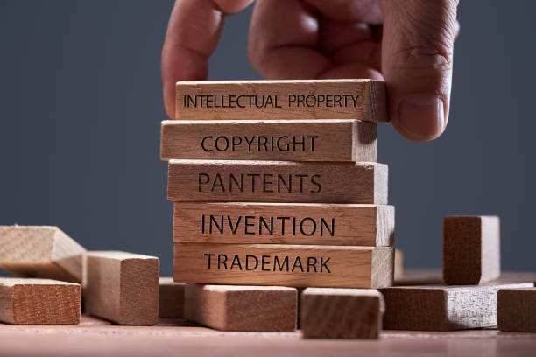
Many appreciate and encourage creativity.
Others exploit talent unfairly, claiming it as their own.
The digital age has made piracy and misuse easier.
REALITY CHECK

Slide 4
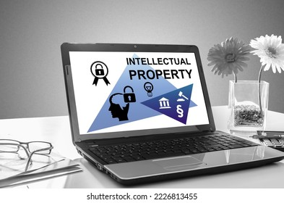
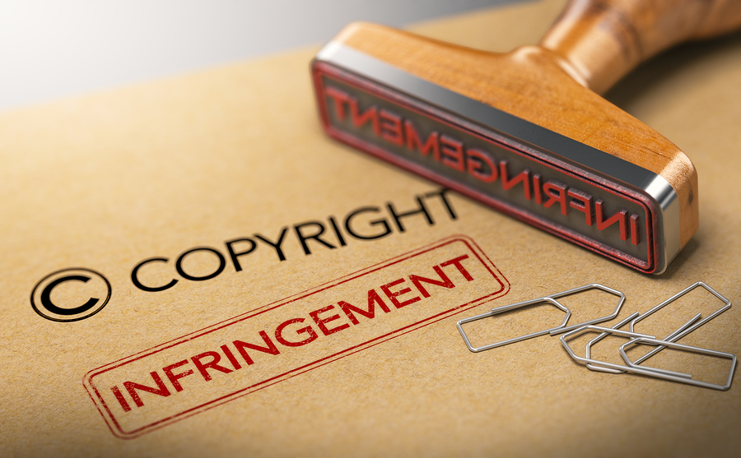
ISSUES & CHALLENGES
Ease of copying, reusing, and redistributing content illegally.
Social media and file-sharing platforms enable unauthorized use.
Creators face significant financial losses.
Difficulty in tracking and removing pirated content quickly.
AI and blockchain technology offer potential solutions for tracking and protecting intellectual property but are not yet widely adopted.
Cybercriminals exploit CREATIVITY for personal gain.

Slide 5
ARGUMENTS
Positive Arguments:
Protects creators' rights by ensuring that their work is not exploited without permission.
Encourages innovation and creativity by giving creators a legal framework to benefit from their ideas.
Promotes a fair digital economy by preventing piracy and unauthorized distribution of content.
Maintains the integrity of content, safeguarding original work from being misused or altered.
Negative Arguments:
Difficult to fully control intellectual property on the internet due to the vast amount of content being uploaded daily.
Excessive control can stifle free expression, limiting the sharing of ideas and innovation.
Implementation can be expensive and difficult for smaller creators to enforce effectively.

Slide 6
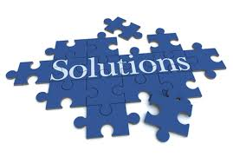
SOLUTIONS
Update IP Laws: Align with digital realities and technological advancements.
Balance Protection & Expression: Maintain free expression while safeguarding creators’ rights.
Technological Tools: Use digital watermarks, to track and protect content.
Global Cooperation: Create a standardized global framework for IP protection.
Education: Raise awareness about the importance of respecting intellectual property.

Slide 7

CONCLUSIONS: The internet has transformed the sharing of intellectual property but has also created challenges . While controlling IP on the internet is complex, it’s essential to protect creators’ rights . A balance must be struck between protecting intellectual property and ensuring free expression. Final Thought: A fair digital economy where creativity thrives is achievable through updated laws, technology, and global cooperation.

Slide 8
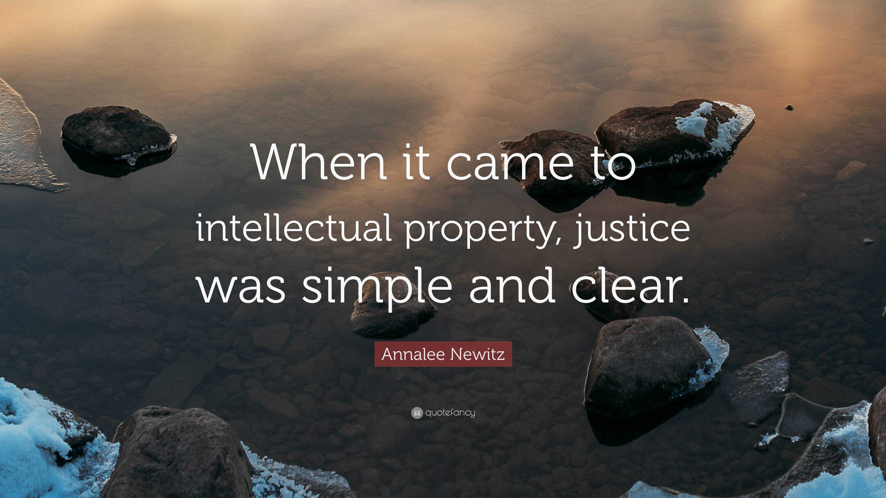
Thank You

